Slide 1
Chapter 7
Pointer
Er. Amrit Poudel

Slide 2
Contents
7.1 Pointers
7.2 Pointer operators
7.3 Types of pointer
7.4 Returning multiple values from function with pointer
7.5 Arrays of pointer
7.6 Pointer to Array
7.7 Relationship between array and pointer
7.8 Pointers for string
7.9 Pointer Arithmetic
7.10 Dynamic Memory Allocation
7.11 Dynamic Array

Slide 3
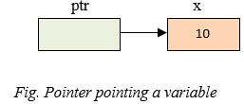
7.1 Pointer
A pointer is a variable whose name starts with an asterisk (*).
It stores the memory address of another variable, i.e. direct address of the memory location.
A pointer can point to one specific datatype (i.e. int or float or double or char).
Eg.
int *ptr;
ptr is a pointer variable which points to variable x.

Slide 4
Pointer Declaration
The general form of a pointer declaration is:
Datatype *variable name;
Where,
datatype refers to the type of data
variable name refers to the name of pointer variable
* is used to declare a pointer.
Eg:
int *x; //pointer to an integer
float *x; //pointer to a float

Slide 5
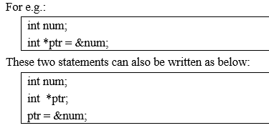
Pointer Initialization

Slide 6
7.2 Pointer Operators
Reference operator
Referencing means taking the address of an existing variable
ampersand (&) sign is used for this.
Eg:
int *p;
p=&x;
Dereference operator
Dereferencing means accessing the value stored in a pointer. T
asterisk(*) sign is used for this.
Eg:
printf("value in pointer:%d\n",*ptr);

Slide 7
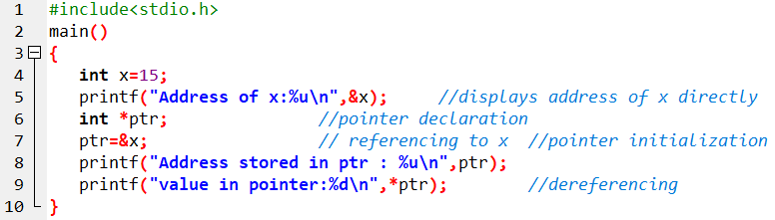

Sample program

Slide 8
7.3 Types of Pointer
Void pointer
Null Pointer
Double Pointer

Slide 9

a) Void Pointer
pointer that can point to variables of any datatype (i.e. single pointer can point to int, float, char or other type variables).
Such pointers use the keyword void.
Using Void pointer, the pointed data cannot be directly dereferenced (i.e. simply using *). For this reason, we need to perform type casting to change the type of void pointer to a specific datatype before dereferencing it.

Slide 10
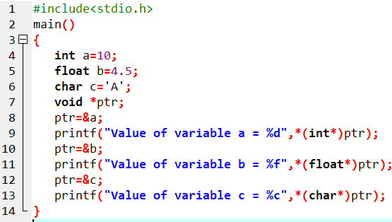

Sample program

Slide 11
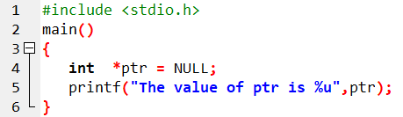

b) Null Pointer
points nowhere or nothing in memory address.
We can define a null pointer using predefined constant NULL
In case we do not have address to be assigned to the pointer, then we simply use NULL.

Slide 12
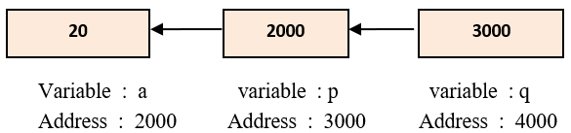
c) Double Pointer
Double pointer refers to a chain of pointer in which one pointer points to another pointer and these in turn point to data.
In case of pointer to pointer declaration, we need to add asterisk(*) for each level of reference.
Here, pointer q holds the value of variable a.

Slide 13
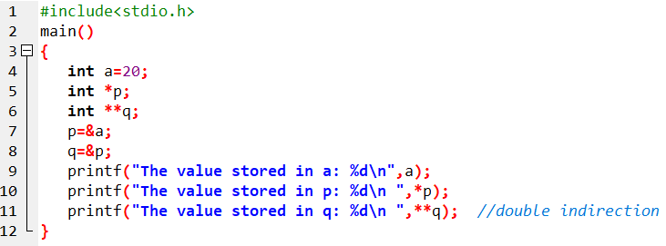

Sample program

Slide 14
7.4 Returning Multiple values from function using pointers
Already dealt in Chapter 6 : Functions

Slide 15
7.5 Arrays of pointer
Basically its an array of pointers that stores memory addresses.
Syntax:
Datatype *pointer-name[size];
Eg.
int *p[5];
Here, p is an array of 5 pointers, each of which points to an integer.
The 1st pointer is called p[0],
the 2nd is p[1], and
so on up to p[4].

Slide 16
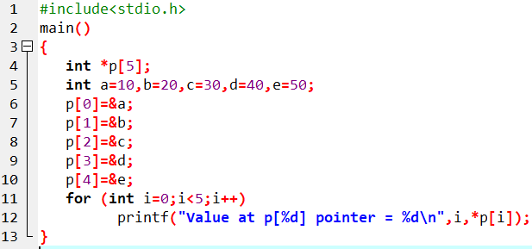
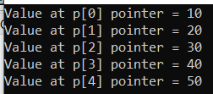
Sample program

Slide 17
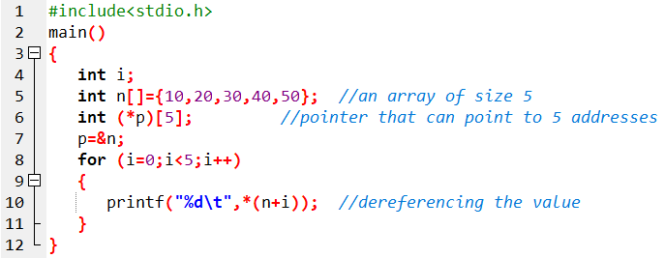
7.6 Pointer to Array
Not only a pointer points to a single variable.
We can also point the whole array using pointers.
Using array pointer, we can easily manipulate the mulit-dimensional array.
Here, pointer p points the entire array n.

Slide 18
7.7 Relationship between array and pointer
An array is a block of sequential data.
In most contexts, array names decay to pointers.
In simple words, array names are converted to pointers.
That's the reason why we can use pointers to access elements of arrays.

Slide 19
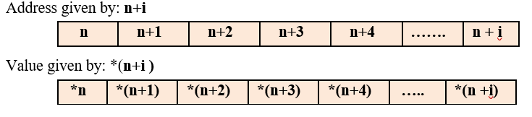
1-D array and Pointer relationship

Slide 20
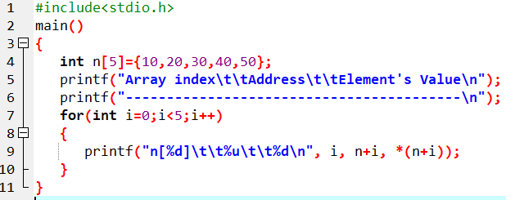
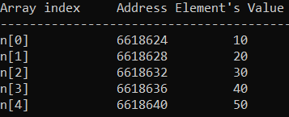
WAP to initialize an 1D array of 5 elements as 10, 20, 30, 40, 50 and display the elements with their memory address using array name as a pointer

Slide 21
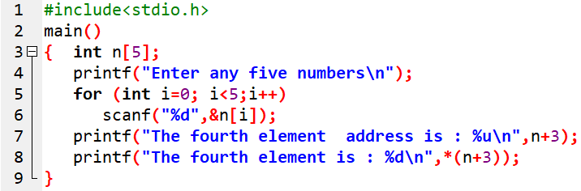

WAP using array to accept any five numbers and display the value stored only in the fourth address of the array using pointer and also its address.

Slide 22
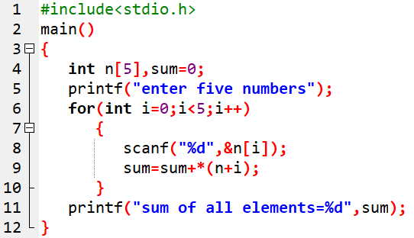

WAP using array to input any five numbers and compute the sum of all the elements using pointer.

Slide 23
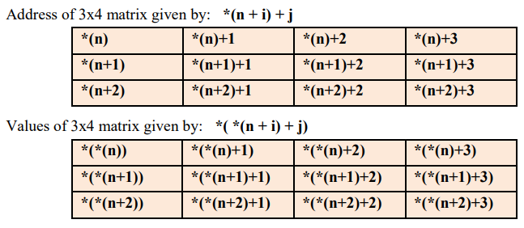
Relationship between 2-D array and pointer

Slide 24
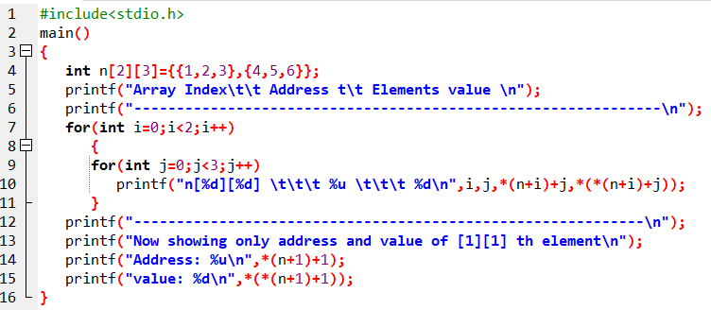
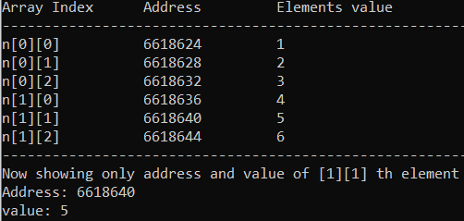
WAP to initialize any 2x3 matrix at compile time and display the address and value stored in it. Also display the address of the element at index[1][1] separately.

Slide 25
7.4 Pointers for string
A string is an array of character.
An array name is itself pointer which points to first element of the array.
Thus, string and pointer are closely related.
Eg.
char name[5] = “Shiva”; // equivalent to char *name = “shiva”;
Here, the string variable name is an array of characters (i.e. * name is a pointer).
Thus it can be used to access and manipulate the characters of the string.
name prints “Shiva”
name+1 prints “hiva”
name+2 prints “iva” and so on.
name + i prints the characters in string name starting from the i^{th} position.

Slide 26
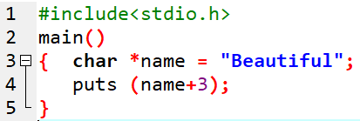

Sample program

Slide 27
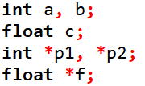
7.9 Pointer Arithmetic
We can perform various operations on pointer like as operation on ordinary variables.
Let's us consider the below declaration:

Slide 28
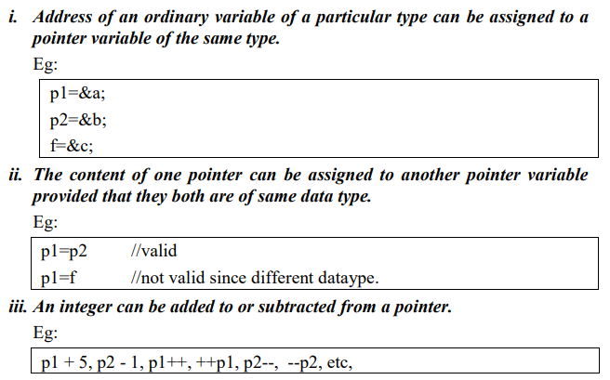

Slide 29
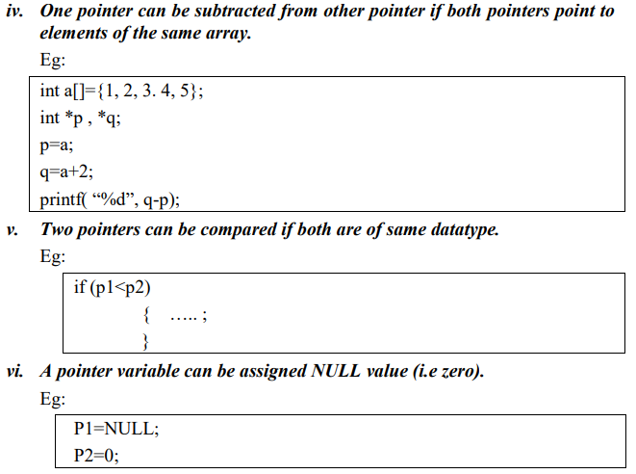

Slide 30
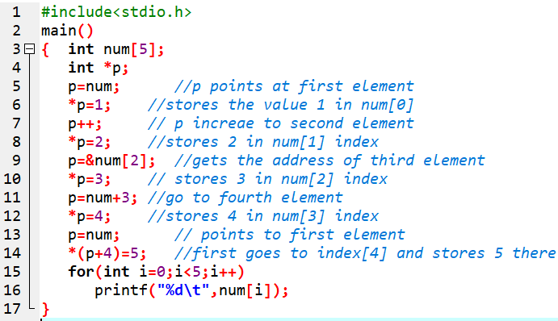

Sample program

Slide 31
7.10 Dynamic Memory Allocation
Arrays can be used for data storage, but they are fixed in size.
The programmer must know the size of the array or data in advance while writing the program.
But it is not possible to know the size of required memory at the time of writing the source code.
So to overcome this limitation, we use DMA technique.
DMA is the process of allocating and freeing memory in a program at runtime.
The DMA process reserves the memory required by the program and allows the program to utilize the memory.
If the allocated memory is no more in use, it returns the allocated memory to the system.
The deallocated memory now is free and any other program can use it.

Slide 32
There are four different library functions in C for memory management which are defined within header file stdlib.h and alloc.h
S.No | Functions | Purpose
1. | malloc() | Allocates required size of bytes and returns a pointer to the first byte of the allocated space to the program.
2. | calloc() | Allocates space for an array of elements and then sets all bytes to zero.
3. | realloc() | Modifies the size of previously allocated space.
4. | free() | Frees previously allocated space.

Slide 33
i) malloc ()
It allocates requested size of bytes and returns a pointer to the first byte of the allocated space.
It creates a single block of memory.
Syntax:
Pointer variable = (datatype *) malloc (sizeof block);
Eg:
x = (int *) malloc (100 *sizeof (int));
Here, sizeof (int) gives 2.
Thus, memory space of 100*2 bytes is reserved. And pointer x points to the first address of the allocated memory.
Also it can be written as:
x = (int *) malloc (200);

Slide 34
ii) calloc ()
It allocates multiple block of storage, each of the same size and then sets all bytes to zero.
Syntax:
Pointer variable = (datatype *) calloc( no of blocks, sizeof each block);
Eg:
x = (int *) calloc (5 ,sizeof (int));
Or
x = (int *) calloc ( 5, 2 );
The above statements allocate contiguous memory space for 5 blocks each of size 2 bytes.

Slide 35
iii) realloc ()
It allows us to modify the memory size of previously allowed space, in case of excess or shortage of the allocated space.
Syntax: (if malloc() was used)
Pointer variable = (datatype *) realloc (pointer, new sizeof block);
Eg:
x = (int *) realloc (x,10);

Slide 36
iv) free ()
It is used to release the space when it is not required.
Syntax:
free (pointer variable);
Eg:
free( x);

Slide 37
7.11 Dynamic Array
An array created at compile time by specifying size in the source code has a fixed size and cannot be modified at run time.
The process of allocating memory at compile time is known as static memory allocation and the arrays that receives static memory allocation are called static arrays.
This approach works fine as long as we know exactly what our data requirements are.
Suppose we don't know what are our data requirements in that case we can use dynamic arrays.
In C, it is possible to allocate memory to arrays at run time.
This feature is known as dynamic memory allocation and the arrays created at run time are called dynamic arrays.
Dynamic arrays are created using pointer variables and memory management functions malloc, calloc and realloc.

Slide 38
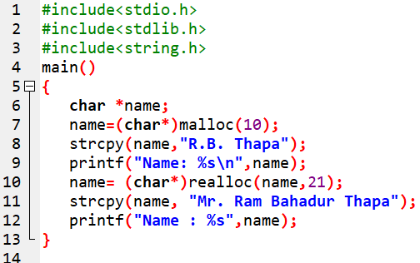

WAP to illustrate the use of malloc() and realloc().

Slide 39
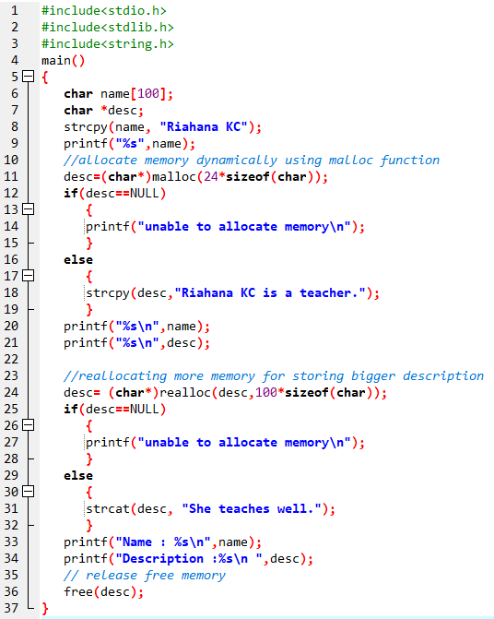
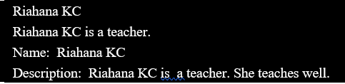
WAP to resize the string “Riahana KC is a teacher.” with new string “Riahana KC is a teacher. She teaches well.”

Slide 40
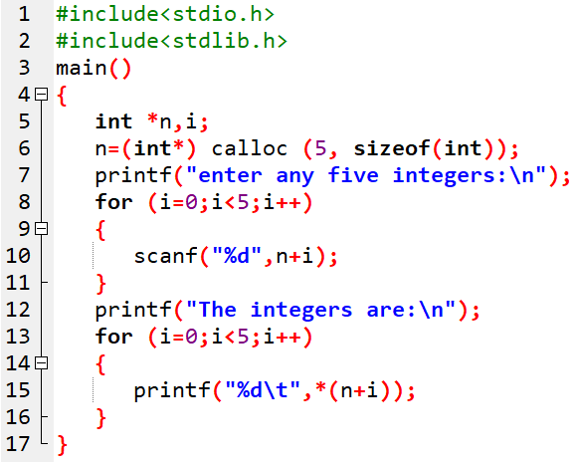
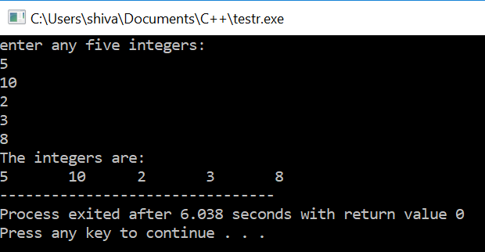
WAP using pointer array to enter any five integers and display them. Use the calloc() function to allocate memory.

Slide 41
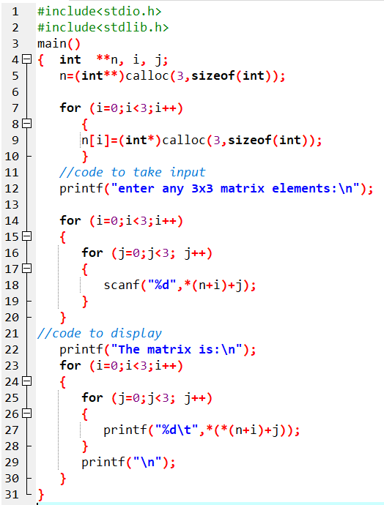
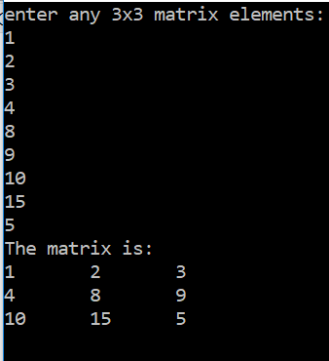
WAP using pointer array to enter a 3*3 matrix and display them. Also make use of calloc() function for DMA.

Slide 42
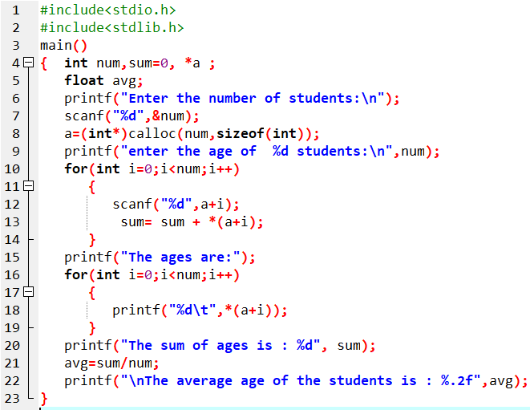
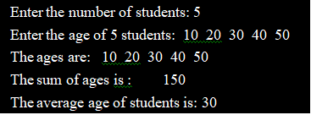
WAP to read n number of students from user and the read the age of each student. Display the entered ages and their average value. Use pointer instead of conventional array to represent ages of different students.

Slide 43
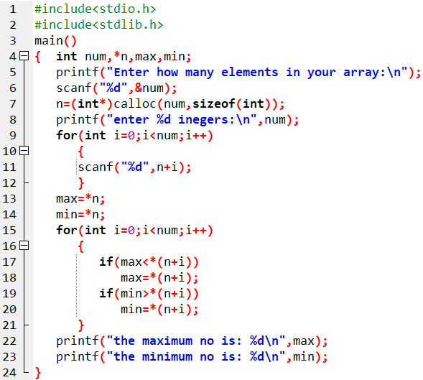

WAP to read a list of integers using DMA and display the largest and smallest elements among them.

Slide 44
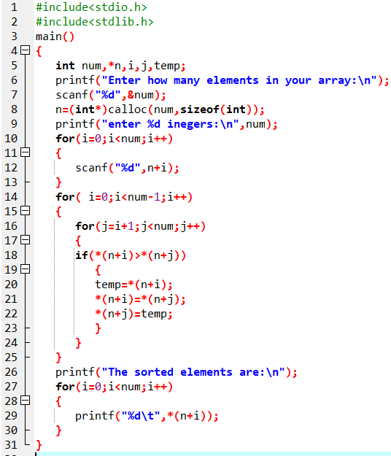

WAP to read n numbers in an array and sort the elements in ascending order. Use dynamic memory allocation.

Slide 45
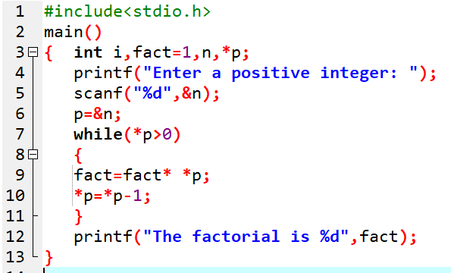

WAP to enter positive integer and find its factorial using pointer.

Slide 46
Assignment:
WAP using pointers to read an array of integers and print its elements in reverse order.
WAP using pointers to accept N integers in an array using DMA and sort them in descending order.
WAP using pointer to accept the elements of 3x3 matrix and display the sum of all the elements.
WAP using pointers to accept the marks of n students using DMA and display the top five marks.

Slide 47
End of Chapter

